Slide 1
Rigidbody Pinball Simulation
Group 3 - Rigid Buddies
Timo Loher, Blanca Gutiez, Tiziano Rutsch

Slide 2
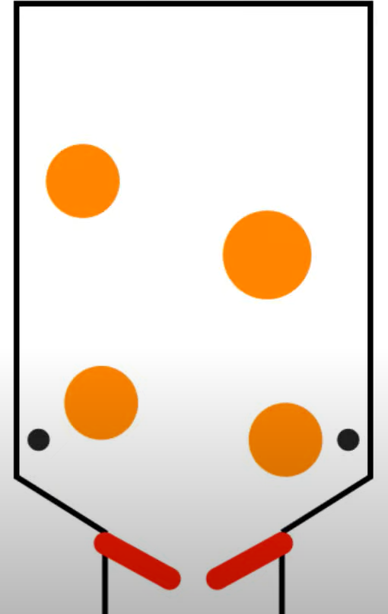
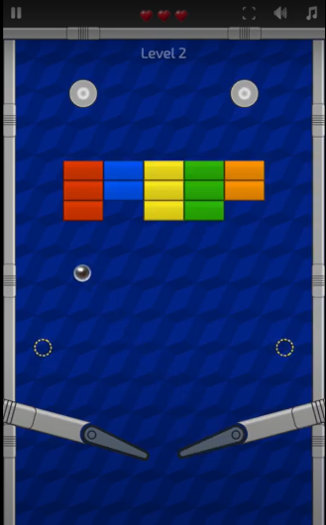
Simulation Scenario
Pinball-type Interactive Game
Destroys bricks
Inspiration:
https://github.com/matthias-research/pages/blob/master/tenMinutePhysics/04-pinball.html#L224

Slide 3
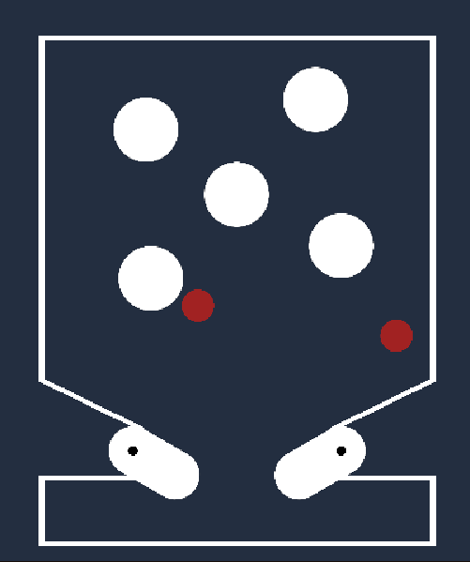
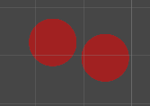
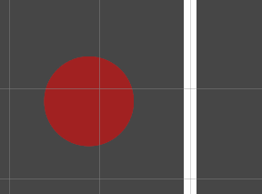
Milestone presentation: Minimal Target
Borders
(static)
3-Phase Collision Detection
Broad Phase: -
Narrow Phase: Exhaustive (ball - any object)
Contact Modelling: sphere-sphere and sphere-bound
Obstacles (static)
Sphere - sphere
Sphere - border
Balls
(movable)
Collision response
Impulse based response
Flippers
(user input)
Numerical integration:
Symplectic Euler
Notes:
Functional Physics Solver
Interaction of Multiple RBs
Gameplay Mechanics

Slide 4
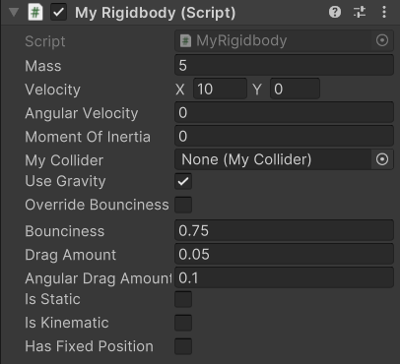
Rigidbody + Collider
Rigidbody + Collider Shapes framework
Spheres and Box Colliders
Fully parameterized objects

Slide 5

Demo

Slide 6

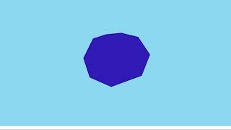
Procedural Fracturing Integration
The simulation can drive the shattering process
The shatter point is the collision point
The resulting shards could be simulated as well

Slide 7
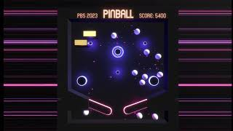
Enhanced Visuals and Gameplay
Simple gameplay
Break boxes and gain more balls
Basic post processing (bloom)
Screen shakes, particles
Shattering was used as a visual effect

Slide 8



Progress
MINIMAL TARGET
Functional Rigid Body Solver
Interaction of Multiple RBs
Pinball Gameplay Mechanics
DESIRED TARGET
More complex shapes of objects
Friction/Drag
Code Optimizations
Interactive pinball + bricks demo
Destructible Objects
Broad Phase Collision Detection
Explore penalty force collision response
Include soft bodies
BONUS TARGET
Improved visuals (3D)
Sound Design
Parallelism
Real time comparison with Unity’s built-in engine

Slide 9
Thanks!

